Slide 1
Ecommerce Dashboard
Built Using Power BI Free Version

Slide 2
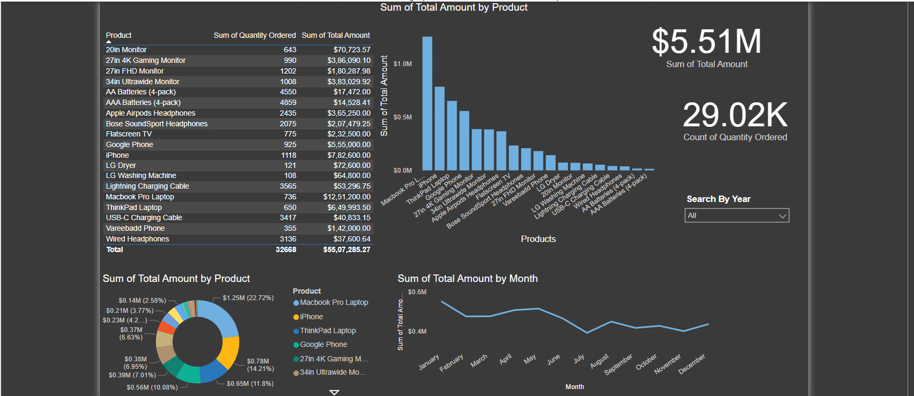
Ecommerce Dashboard
*Screenshots are used to showcase due to sharing limitations
This is my Ecommerce Dashboard

Slide 3
Ecommerce Dashboard
This Table consist all distinct Products with Total Sum of
Each Distinct Products

Slide 4
Ecommerce Dashboard
This Stacked Column Chart
Shows the Most Selling Products by Total Amount

Slide 5
Ecommerce Dashboard
These Cards Contains Total Amount and Total Count of Quantities
This Slicer Slices the Trends By Years

Slide 6
Ecommerce Dashboard
This Donut Chart Shows the
Percentage of the Products in Total Amount

Slide 7
Ecommerce Dashboard
This Line Chart Shows The Trend of sales in months

Slide 8
Thank You !!

